Slide 1



EcoSort AI
AI-Powered Waste Classification System
Team leader: Krishn Khatri
SVIT, Vasad
Mentor: Sagar Chauhan

Slide 2
Project Overview
Problem Statement
Project Overview – Introduction
End Users
Wow Factor in Project
Modelling / Block Diagram / Flow of Project
Result / Outcomes
Conclusion
Future Perspective

Slide 3
Current Problems
Incorrect waste segregation
Low recycling efficiency
Increased landfill waste
Environmental pollution
Lack of public awareness
Proposed Solution
Develop an AI-powered application that classifies waste images into the correct category and provides recycling guidance.

Slide 4
Project Overview - Introdunction
EcoSort AI is an AI-powered waste classification application developed using TensorFlow and Streamlit.
Users simply upload an image of waste.
The trained MobileNetV2 model predicts the waste category and recommends the appropriate recycling method, encouraging sustainable waste management.

Slide 5
End Users
Households
Schools & Colleges
Municipal Corporations
Recycling Centers
Environmental NGOs
Smart City Projects

Slide 6
Wow Factors
AI-powered waste recognition
MobileNetV2 Transfer Learning
6-category classification
High prediction accuracy (~85.7% validation)
User-friendly Streamlit interface
Instant predictions
Supports Green Skills & Sustainability

Slide 7
Wow Factors
Technology Stack
Programming Language
Python
Framework
TensorFlow
Keras
Streamlit
Libraries
NumPy
Matplotlib
Plotly
Pillow
Model
MobileNetV2 (Transfer Learning)
Dataset
TrashNet Dataset
2527 Images
6 Classes

Slide 8
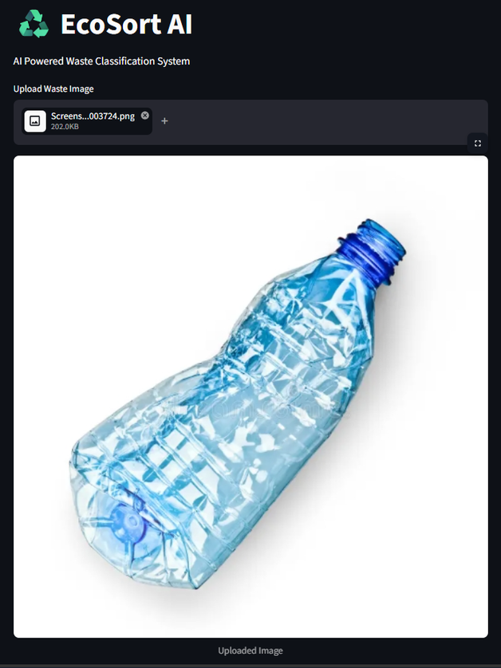
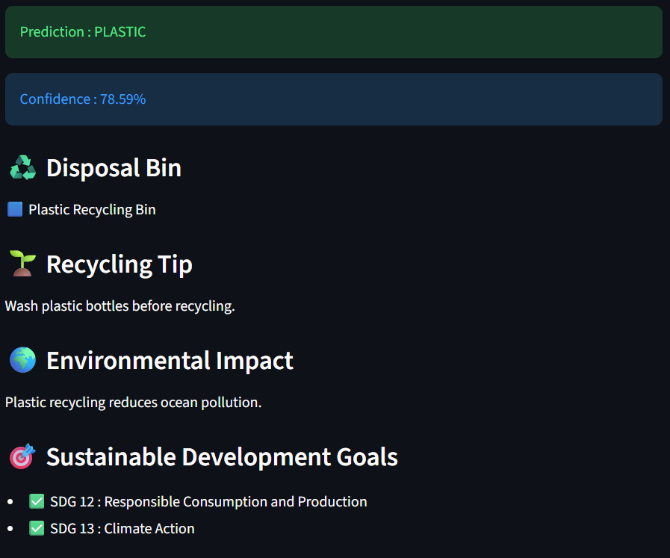
Wow Factors
Model Performance
Training Accuracy: 93.5%
Validation Accuracy: 85.7%
Waste Categories
Cardboard
Glass
Metal
Paper
Plastic
Trash
Output
Correct Waste Category
Confidence Score
Recycling Recommendation

Slide 9
Conclusion
Successfully developed an AI-powered waste classification system.
Achieved high prediction accuracy using MobileNetV2.
Provides quick and reliable waste classification.
Promotes proper recycling practices.
Supports environmental sustainability and Green Skills initiatives.

Slide 10
Future Perspective
Mobile Application
Live Camera Detection
Multi-language Support
Recycling Center Locator
Cloud Deployment
Smart Dustbin Integration
Real-time Waste Detection

Slide 11
Thank You
Github link: https://github.com/KrishnK-22/EcoSortAI
Video link: https://drive.google.com/file/d/1zQNHpsTT-ntsXGYGhQhZ--LAOHtEXfys/view?usp=drive_link

